Slide 1
Imputation of scRNA-seq data
David van Dijk
Internal Medicine & Computer Science @ Yale
vandijklab.org

Slide 2
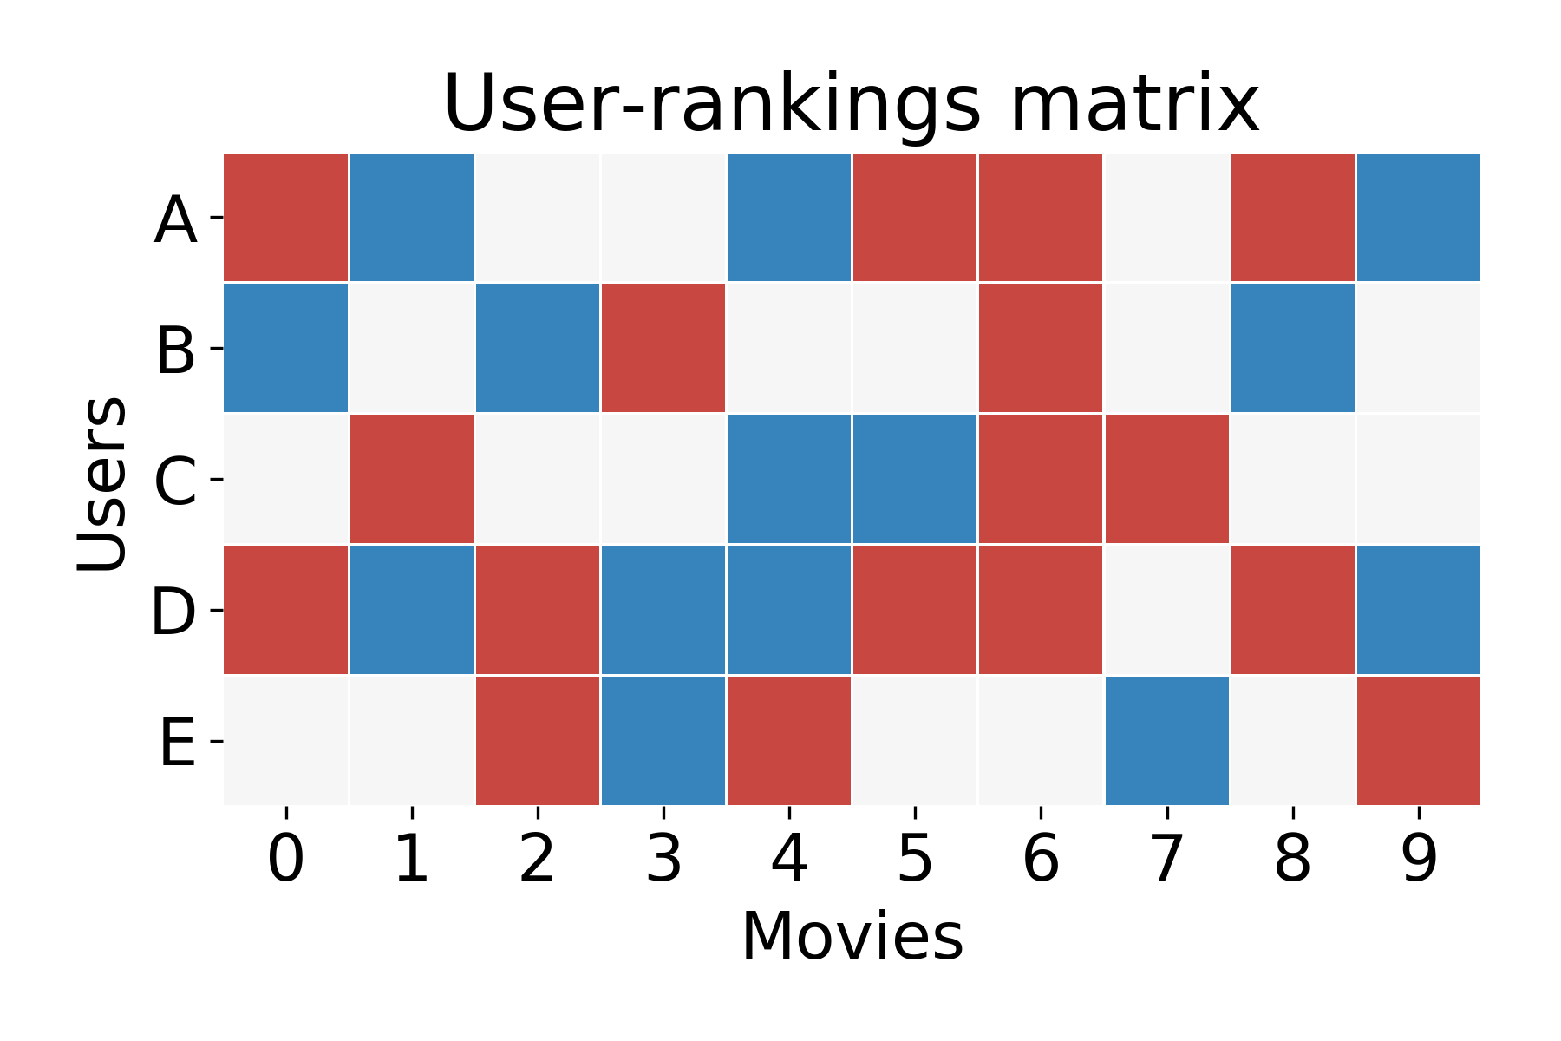
What do we do with missing data?
The Netflix Problem
Rows are users
Columns are “+1” for like and “-1” for dislike
We know which values are missing (unwatched)
Goal: predict missing values to suggest movies to each user

Slide 3
What do we do with missing data?
The Netflix Problem
Rows are users
Columns are “+1” for like and “-1” for dislike
We know which values are missing (unwatched)
Goal: predict missing values to suggest movies to each user
How can we guess missing values?

Slide 4
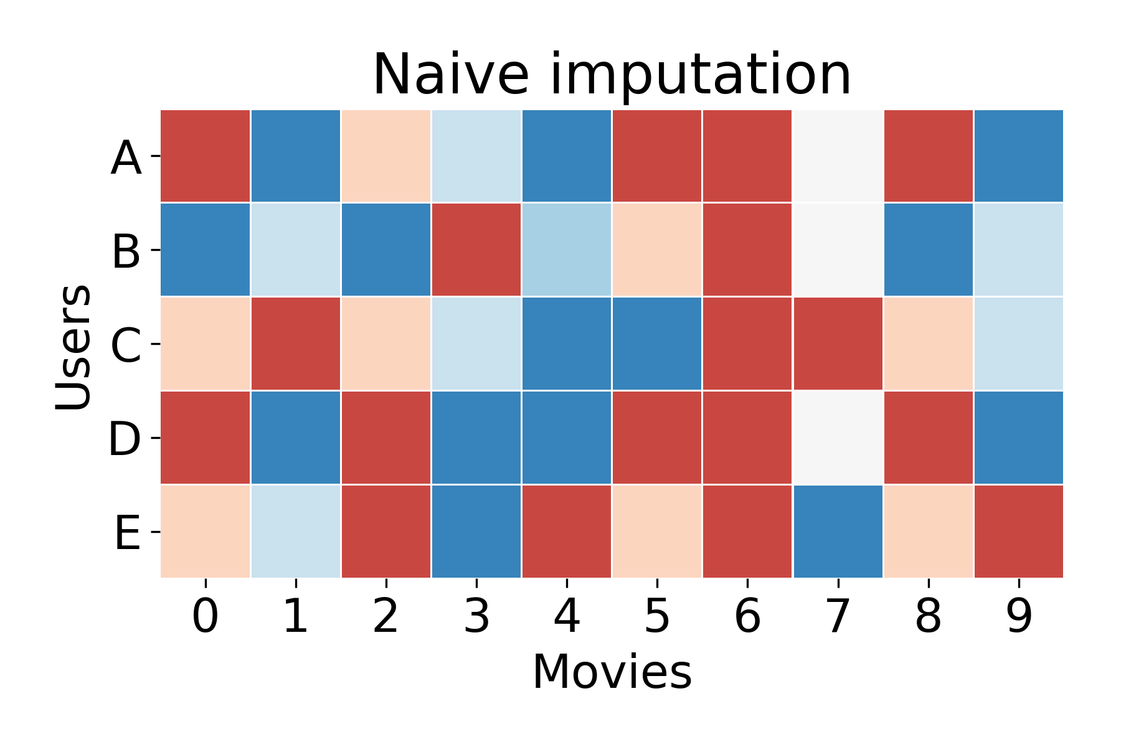
What do we do with missing data?
Naïve solution
Use the average ranking
Raw data

Slide 5
What do we do with missing data?
Naïve solution
Use the average ranking
Raw data
How can we improve on this?

Slide 6
Information redundancy in the user-rankings matrix
Two sources of redundancy
Similarity between movies (e.g. rom-coms, horror movies)
Similarity between users (e.g. “Likers of rom-coms”)

Slide 7
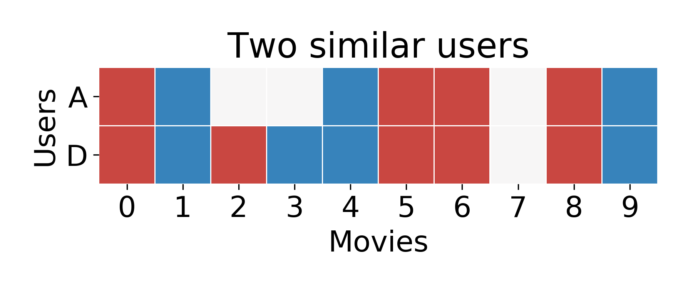
Identifying similar users to impute missing values

Slide 8
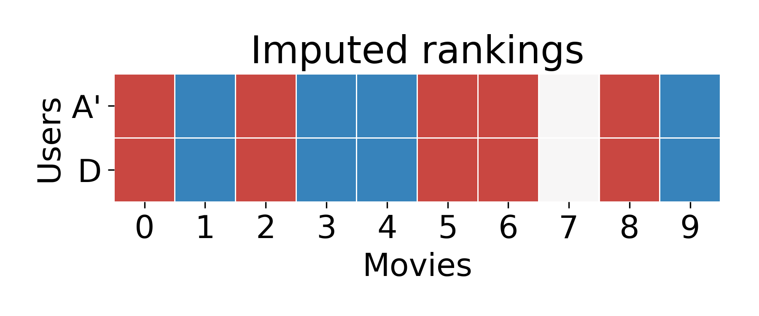
Identifying similar users to impute missing values

Slide 9
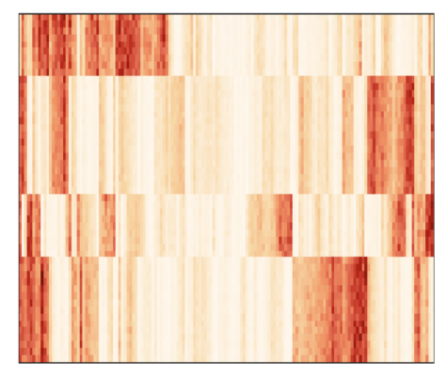
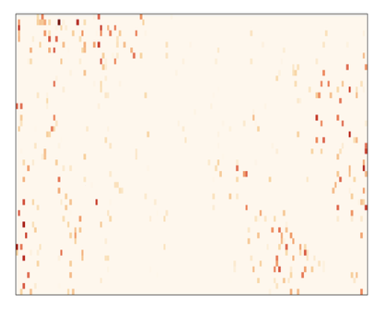
Problem: scRNA-seq data is sparse and noisy
How do we we know which values to impute?
True structure
Noisy measurement
cells
~90% missing
genes
We only capture ~5-15% of the transcripts per cell due to inefficient RT in small volumes
Notes:
Dropout result of inefficient reverse transcription in small volumes

Slide 10
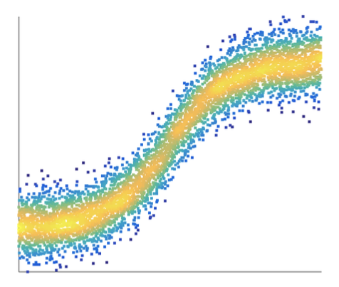
MAGIC Markov Affinity-based Graph Imputation of Cells (van Dijk et al. Cell, 2018)
Main idea: cells learn values from their neighbors, gaining information from similar cells while retaining their individual identity.

Slide 11
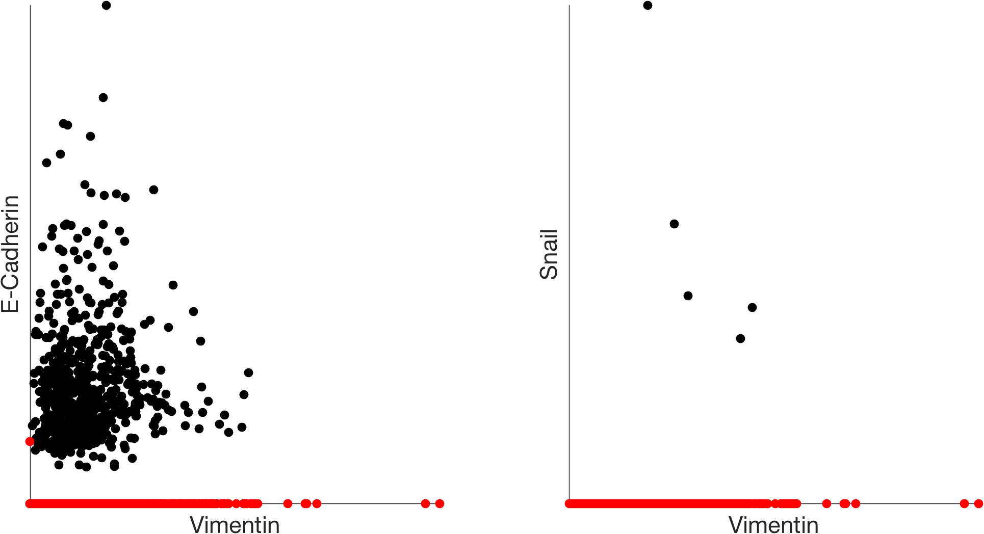
HMLE breast cancer cell line, TGF-β induced EMT
Detected in only 5 cells
missing values
dropout obscures gene-gene relationships
Notes:
Vimentin – intermediate filament expressed in mesenchymal cells
E-cadherin (epithelial cadherin) – involved in cell adhesion (expressed early in development)
Snail – TF that promote the repression of E-cadherin, known to regulate EMT

Slide 12
Solution: Recover data by learning from similar cells
Similar
cells
Cells
Genes
Biologically similar cells will have similar expression
Cells “exchange” information

Slide 13
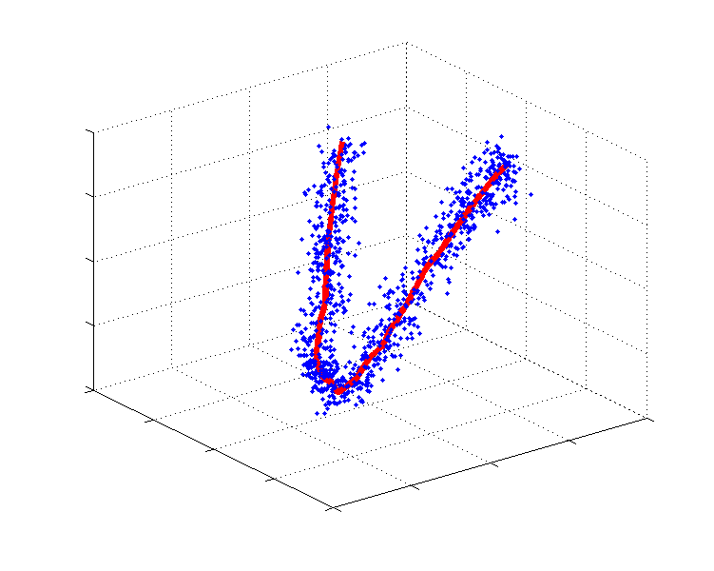
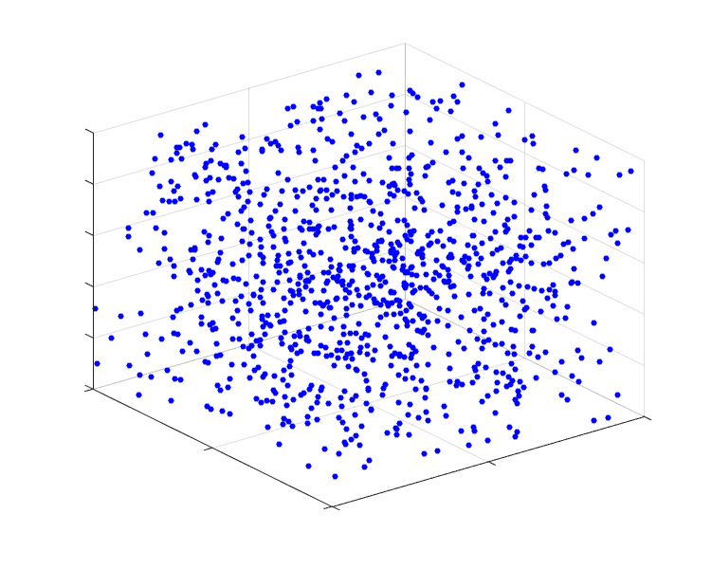
Low dimensional structure
Many features (e.g. genes) but high degree of redundancy
Features are correlated
States (e.g. cell types) are constrained
Notes:
Gene expression has redundancy due to genes being co-regulated. E.g. TF-target pairs, or genes coding for part of the same protein complex
This means that certain cell configurations can not exist
Thus, the high dimensional data lies on a lower dimensional ‘manifold’
explain that concept slower, with some animation and text. Here is my data it does not take all the space these are empty areas (animate red circles), the data follows a 1D trajectory which can be approximated by this line (add red line).

Slide 14
Manifold
Locally Euclidean
Smooth
Low dimensional
Data has a “shape”

Slide 15
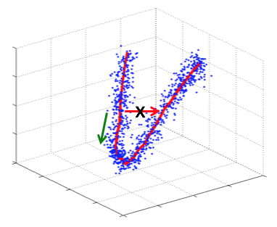
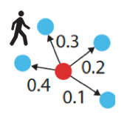
Manifold learning via data diffusion
Biological neighborhood = manifold
Walk via small local steps
Random walk = diffusion
Notes:
Global distance is not reliable, but local Euclidean steps are
We can use local Euclidean steps to “diffuse” through the manifold
Diffusion is equivalent to a random walk

Slide 16
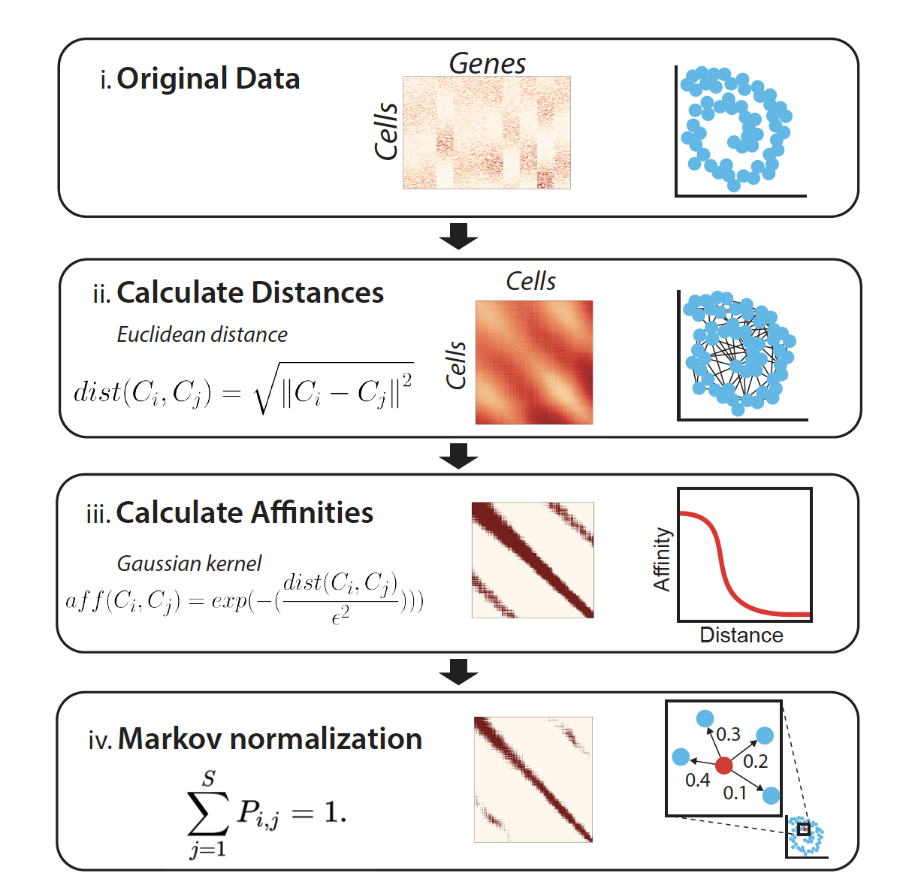
The Algorithm

Slide 17
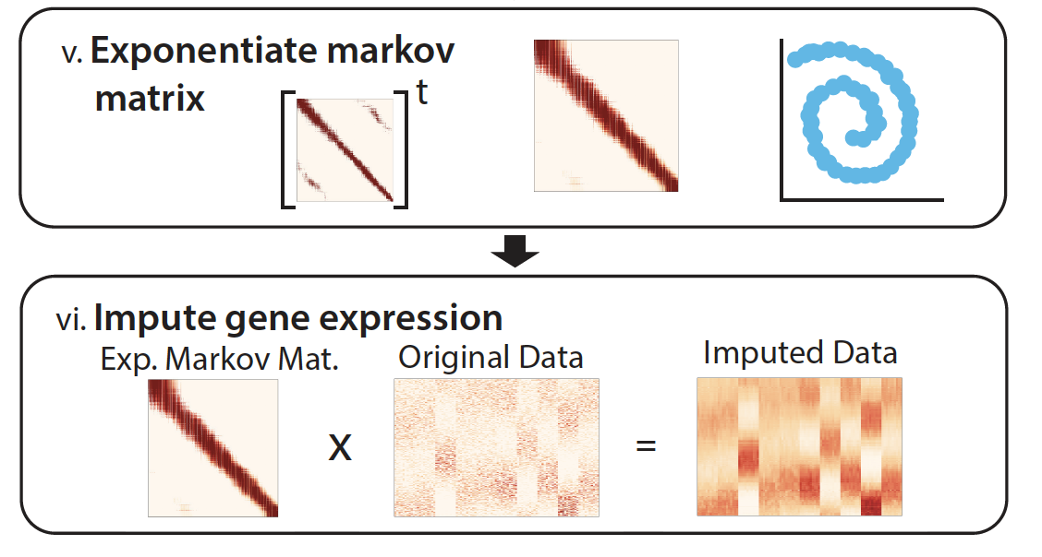
Diffusion and imputation step

Slide 18
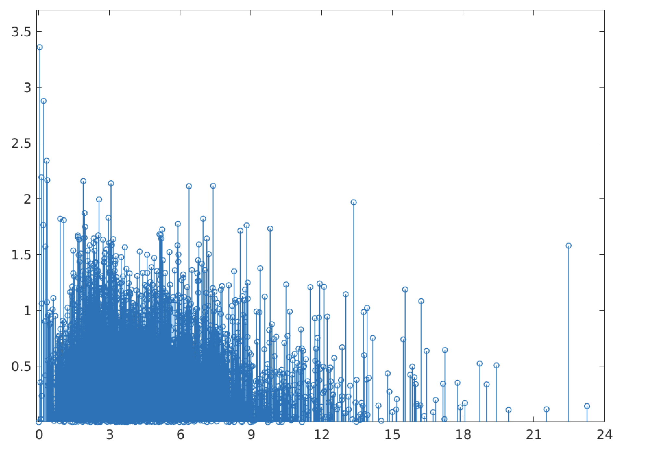
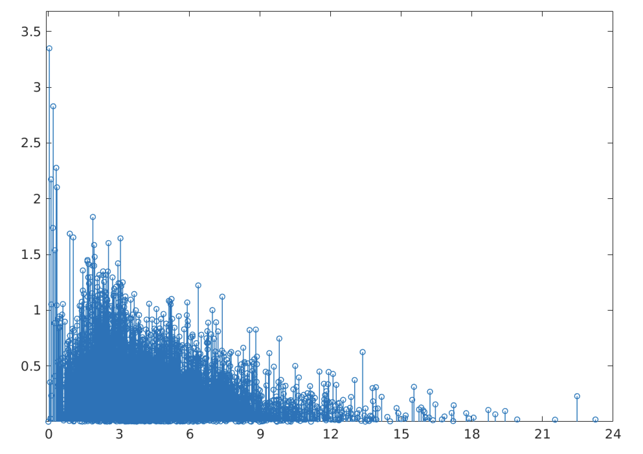
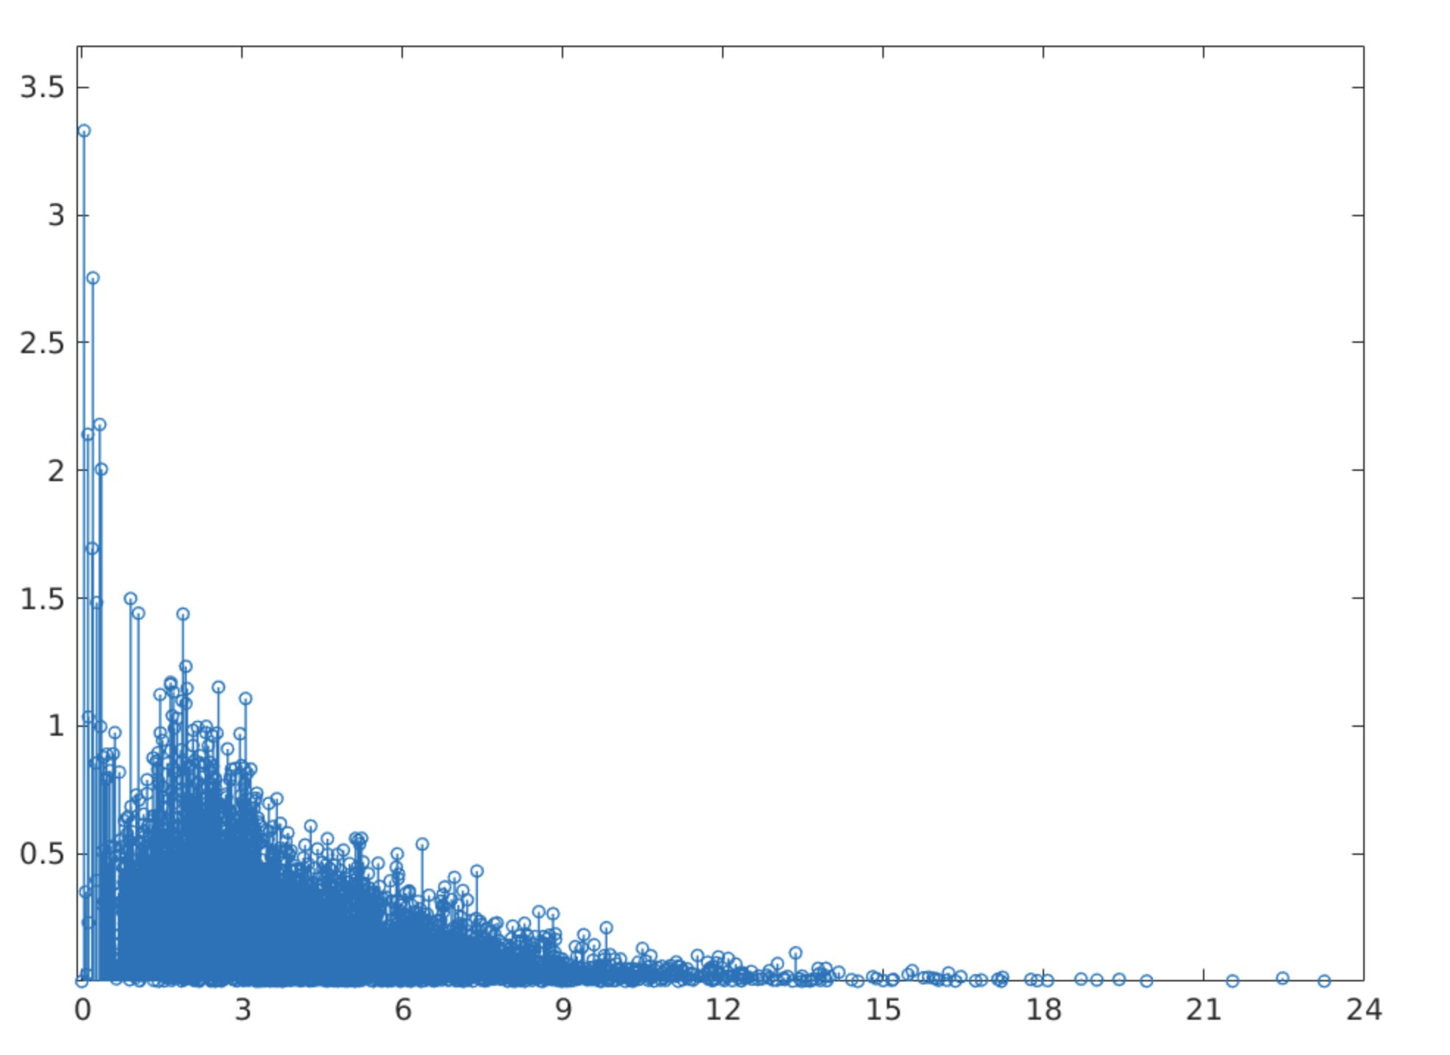
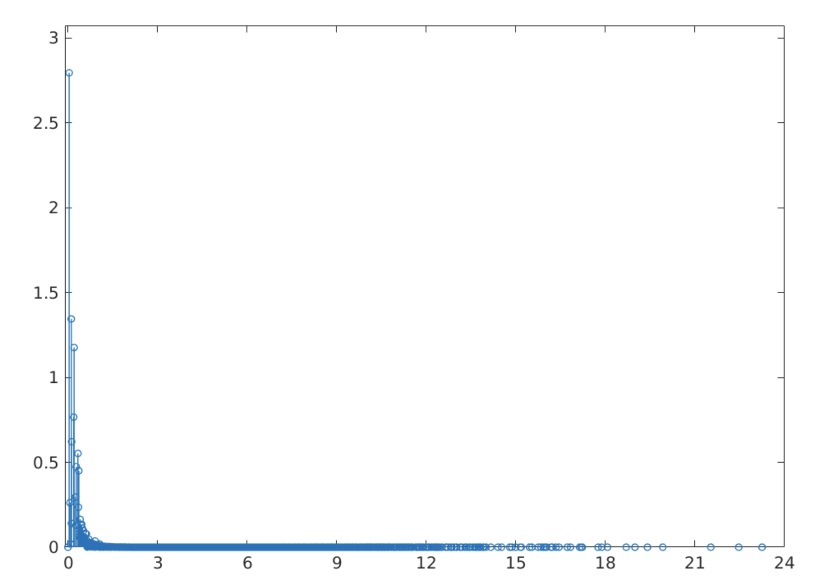
Graph diffusion = low pass filter on graph spectrum
t = 0 (no smoothing)
t = 2
Low frequency signal
High frequency noise
t = 5
t = 100

Slide 19
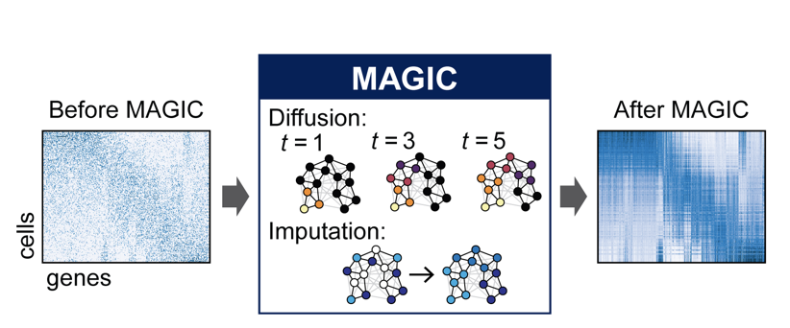
Markov Affinity-based Graph Imputation of Cells (MAGIC)

Slide 20
missing values
original data with dropout

Slide 21
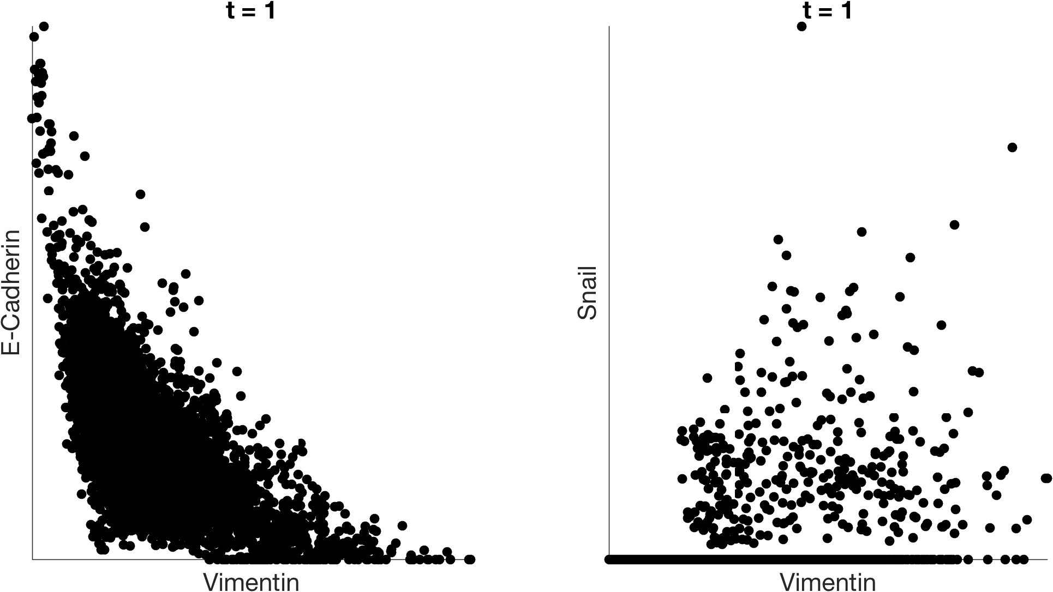
imputation with MAGIC

Slide 22
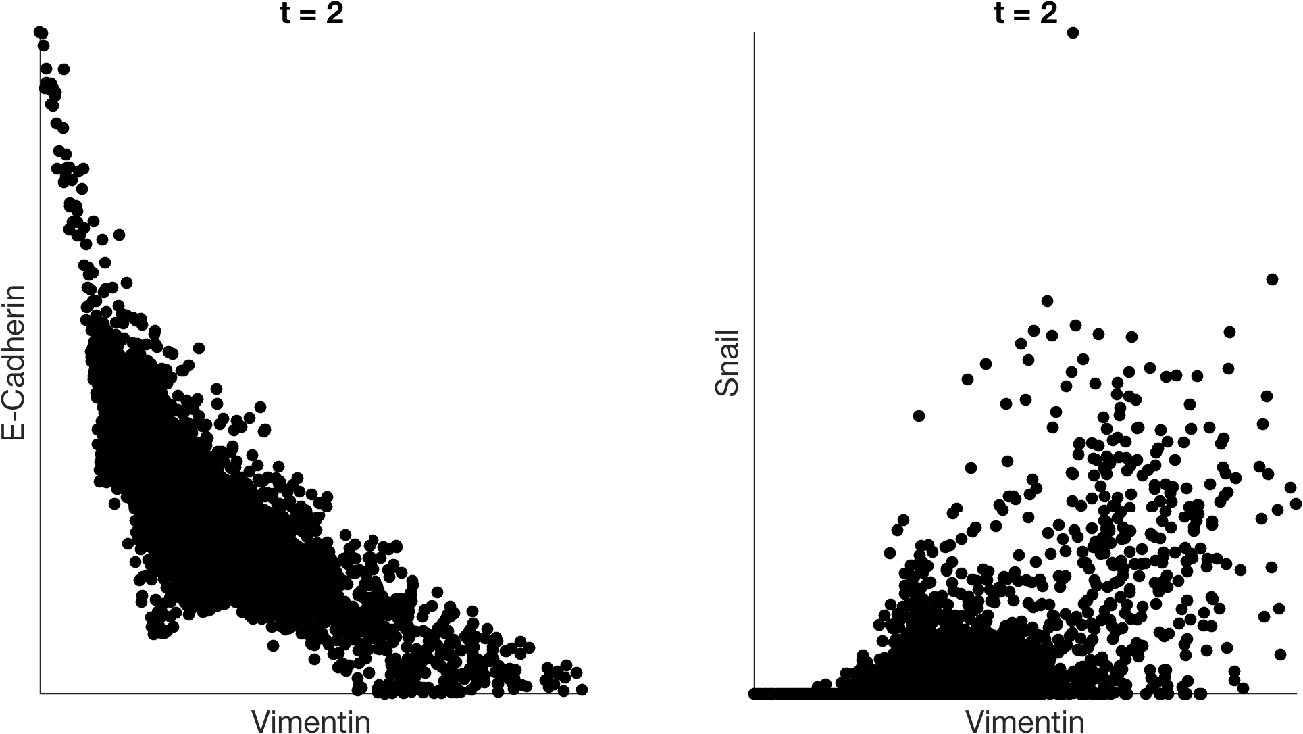
imputation with MAGIC

Slide 23
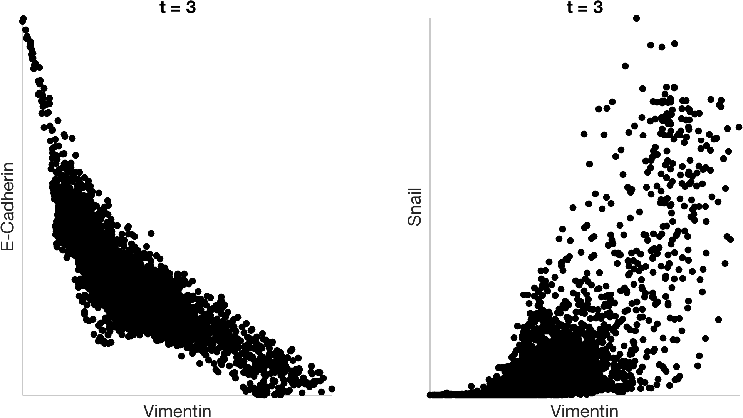
imputation with MAGIC

Slide 24
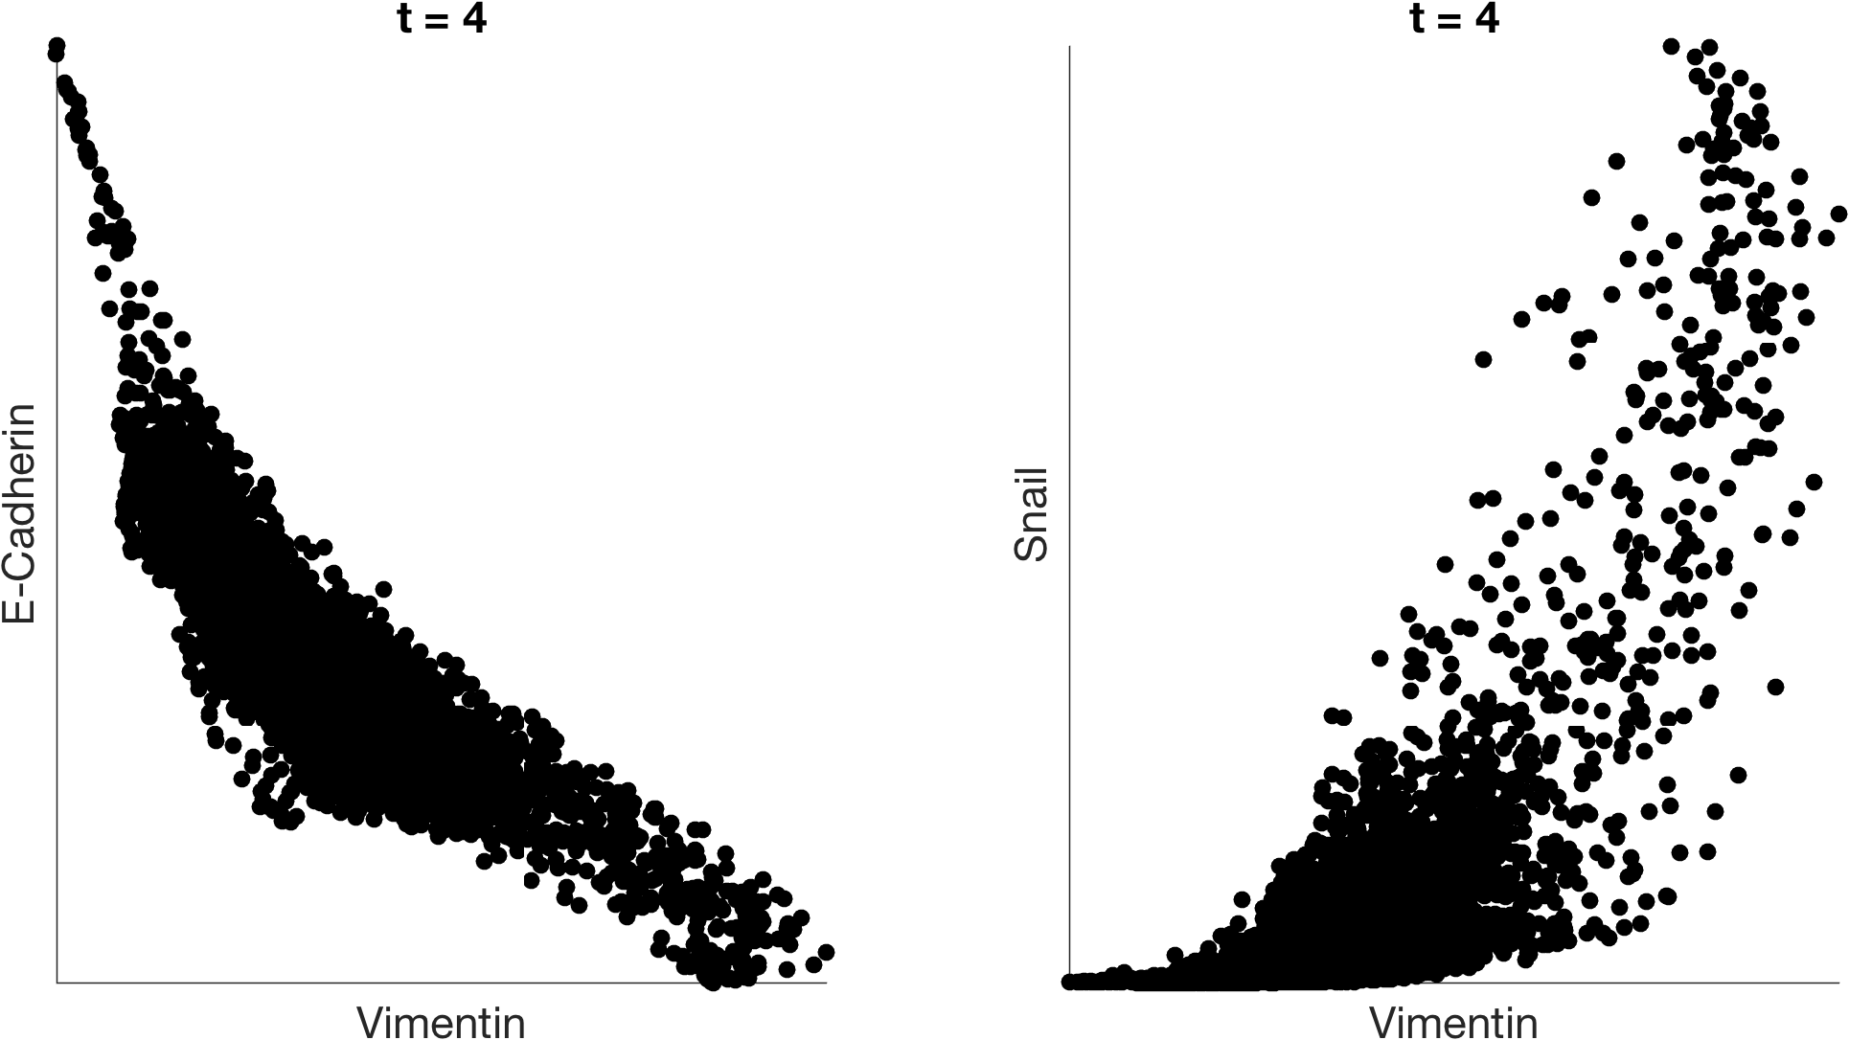
imputation with MAGIC

Slide 25
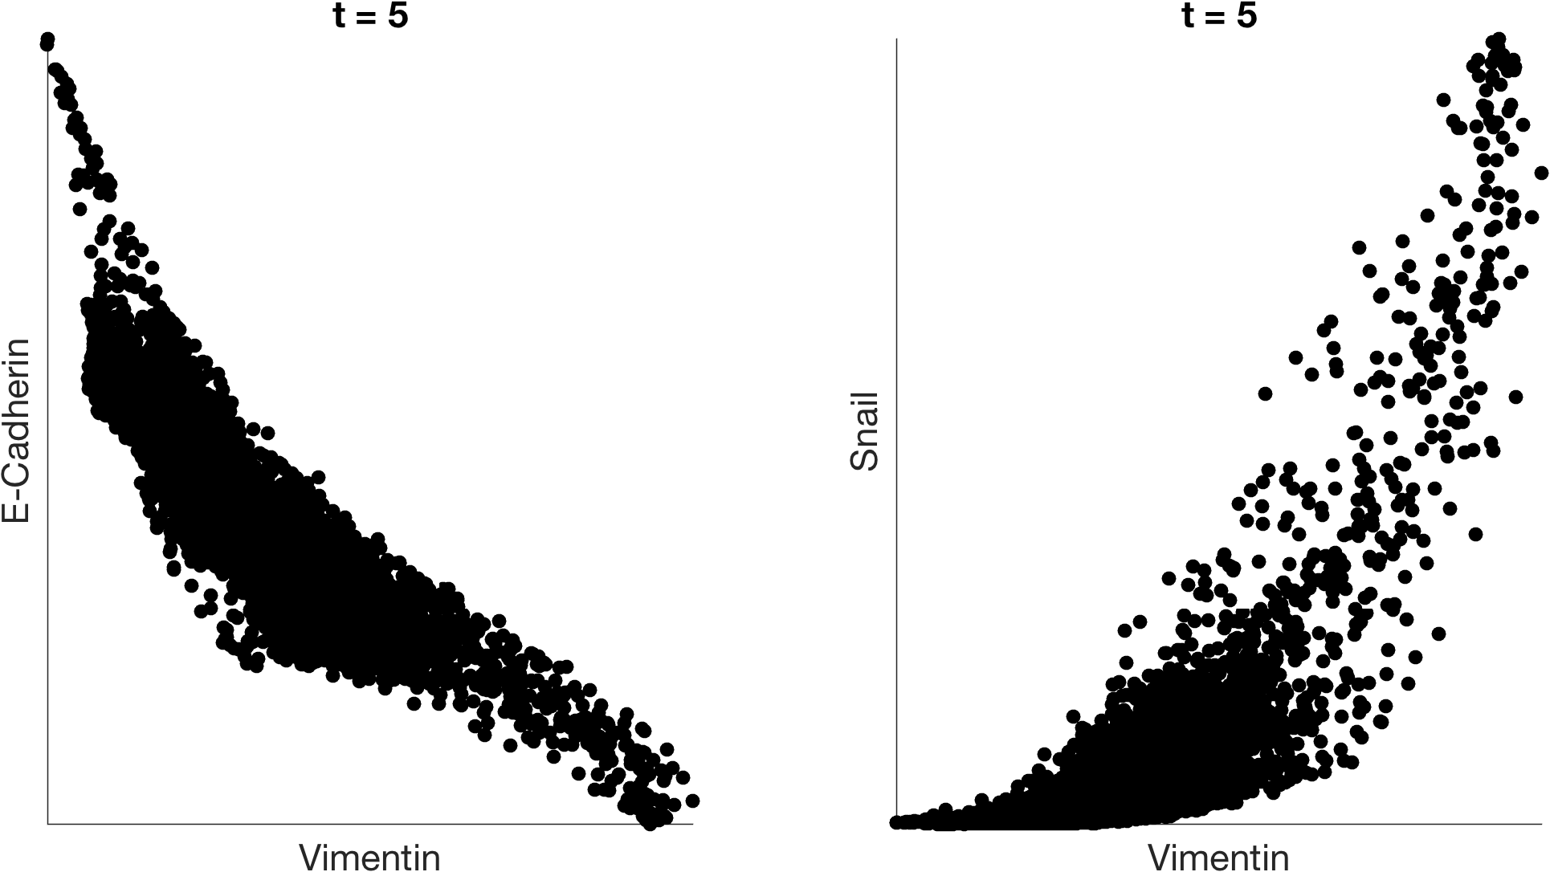
imputation with MAGIC

Slide 26
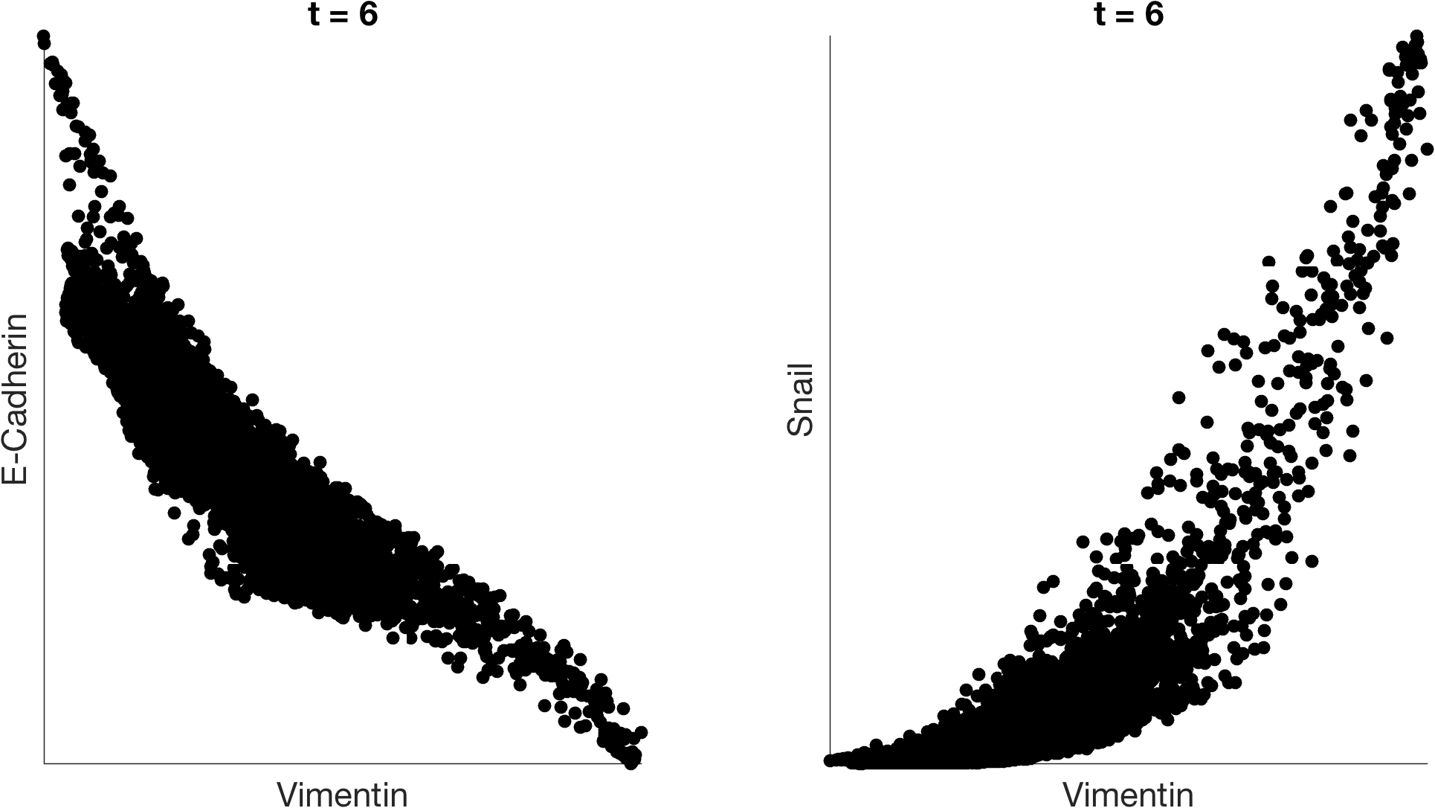
imputation with MAGIC

Slide 27
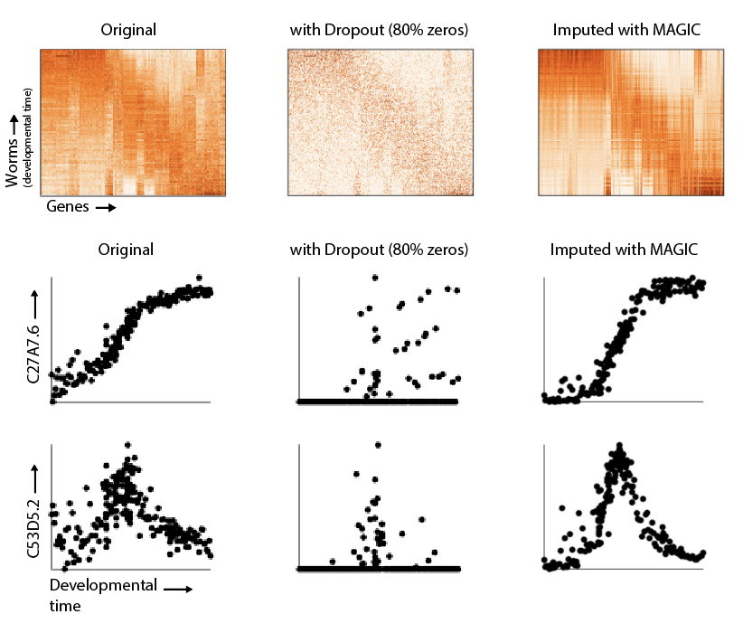
(Francesconi, 2014, Rockman, 2010)

Slide 28
(Francesconi, 2014, Rockman, 2010)

Slide 29
R² = 0.78
(Francesconi, 2014, Rockman, 2010)

Slide 30
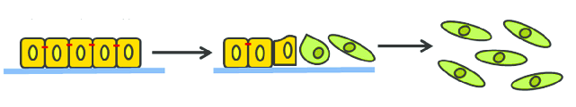
TGF-β induced EMT (epithelial-to-mesenchymal transition)
Epithelial markers
Mesenchymal markers
e.g.: E-cadherin, Laminin-1
e.g.: Vimentin, Snail, Zeb
With Weinberg Lab (Whitehead):
Diwakar Pattabiraman, Brian Bierie, Christine Chaffer

Slide 31
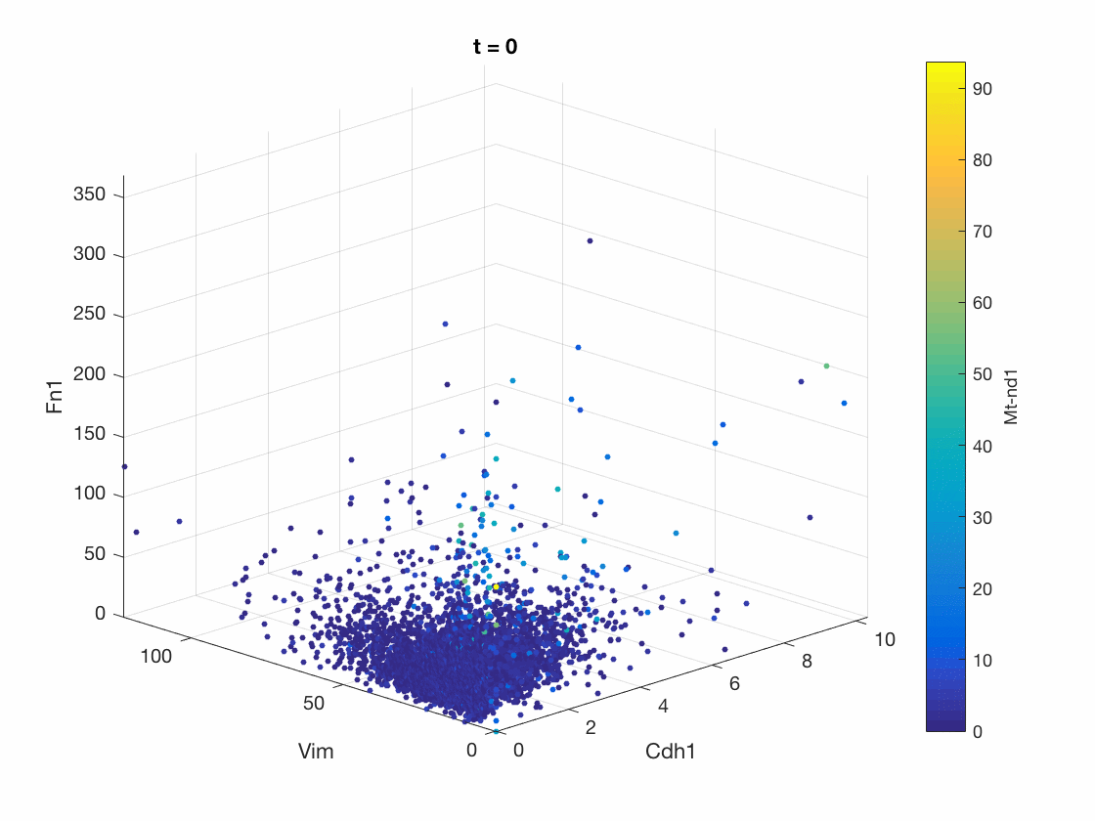
MAGIC reveals EMT continuum
Fibronectin
Vimentin
E-cadherin
32

Slide 32
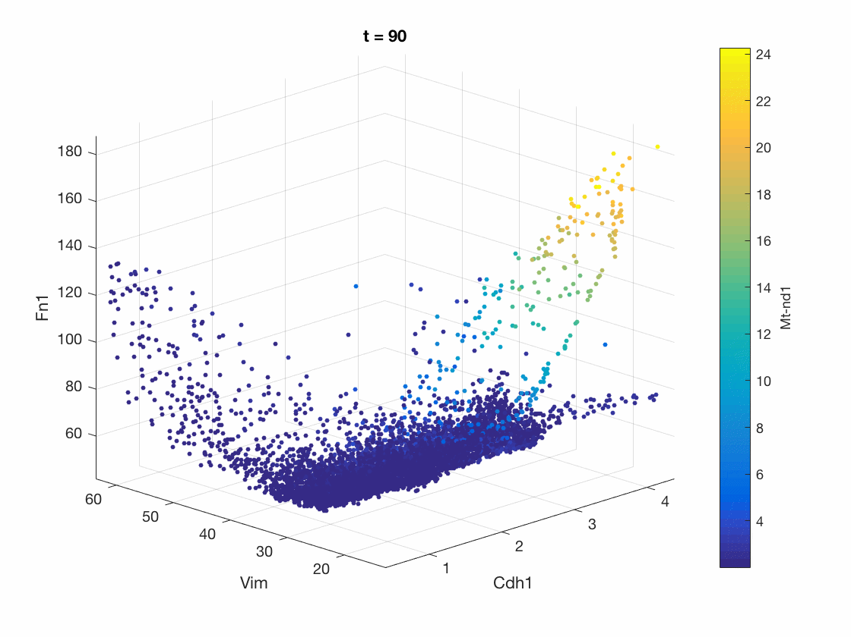
MAGIC reveals EMT continuum
Mesenchymal
Epithelial
Apoptotic
M
A
Fibronectin
E
Vimentin
E-cadherin
Notes:
Add arrows

Slide 33
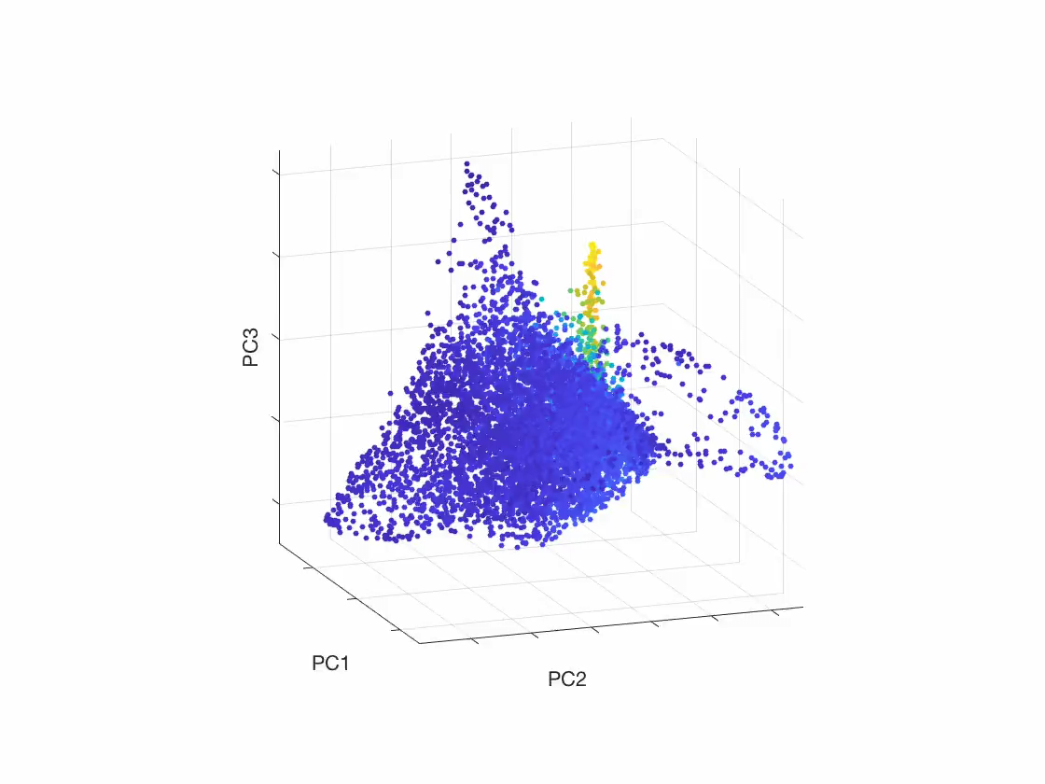
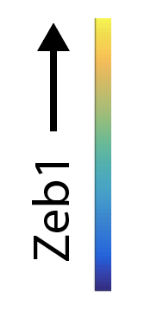
MAGIC reveals complex cellular state-space

Slide 34
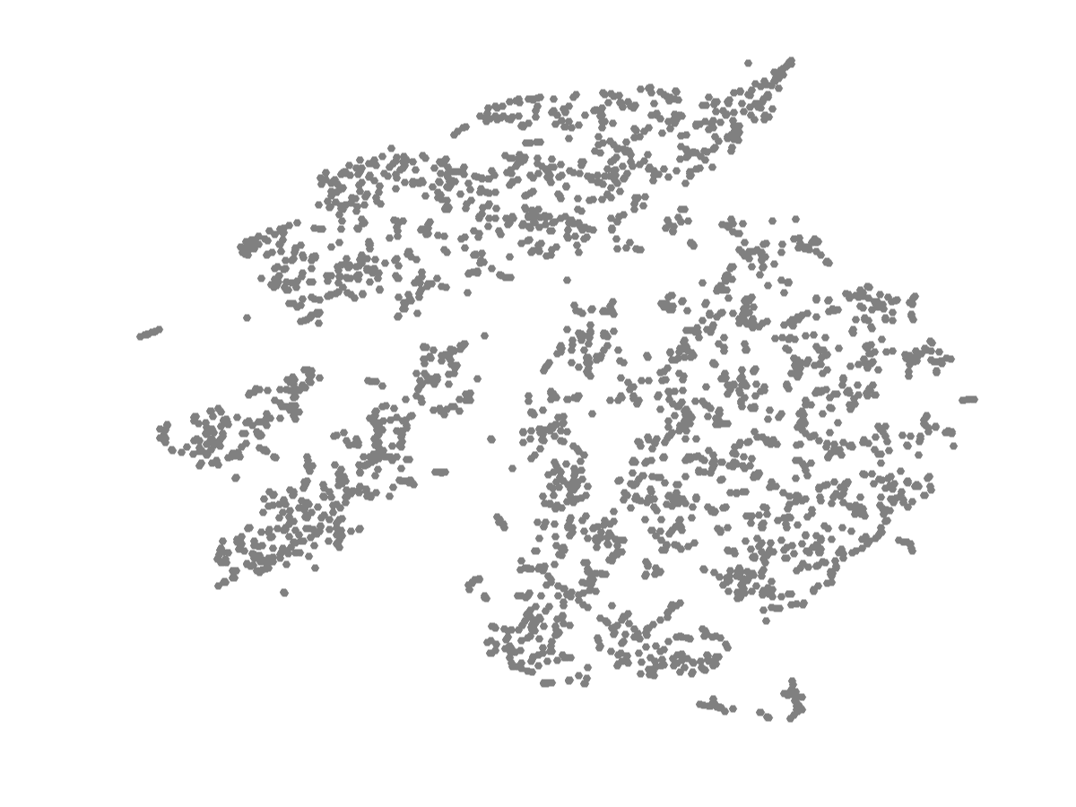
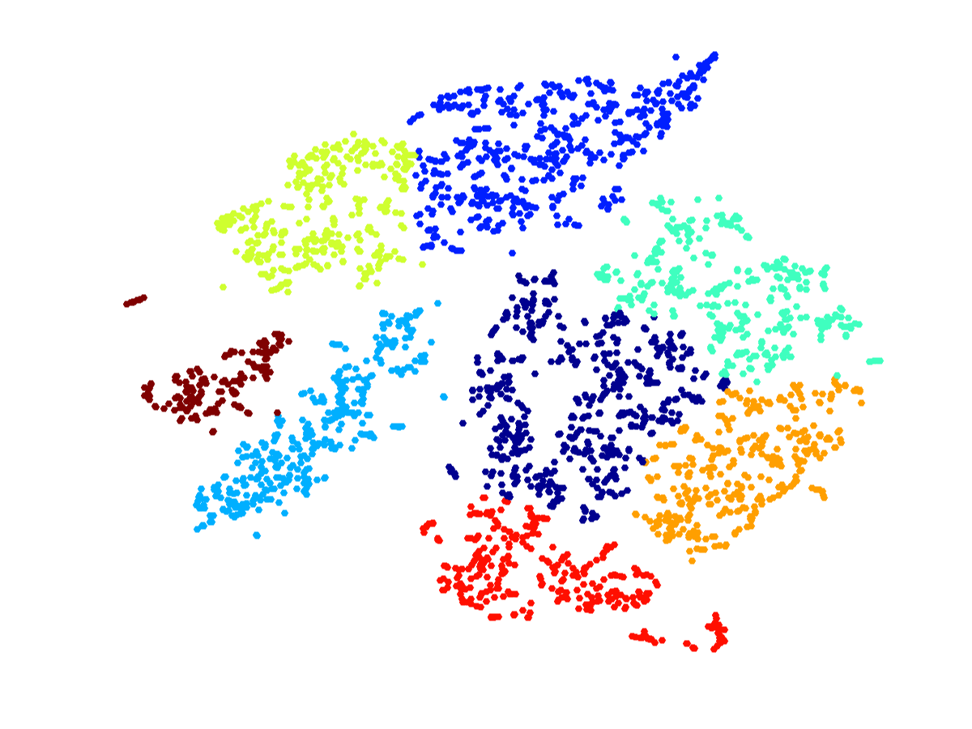
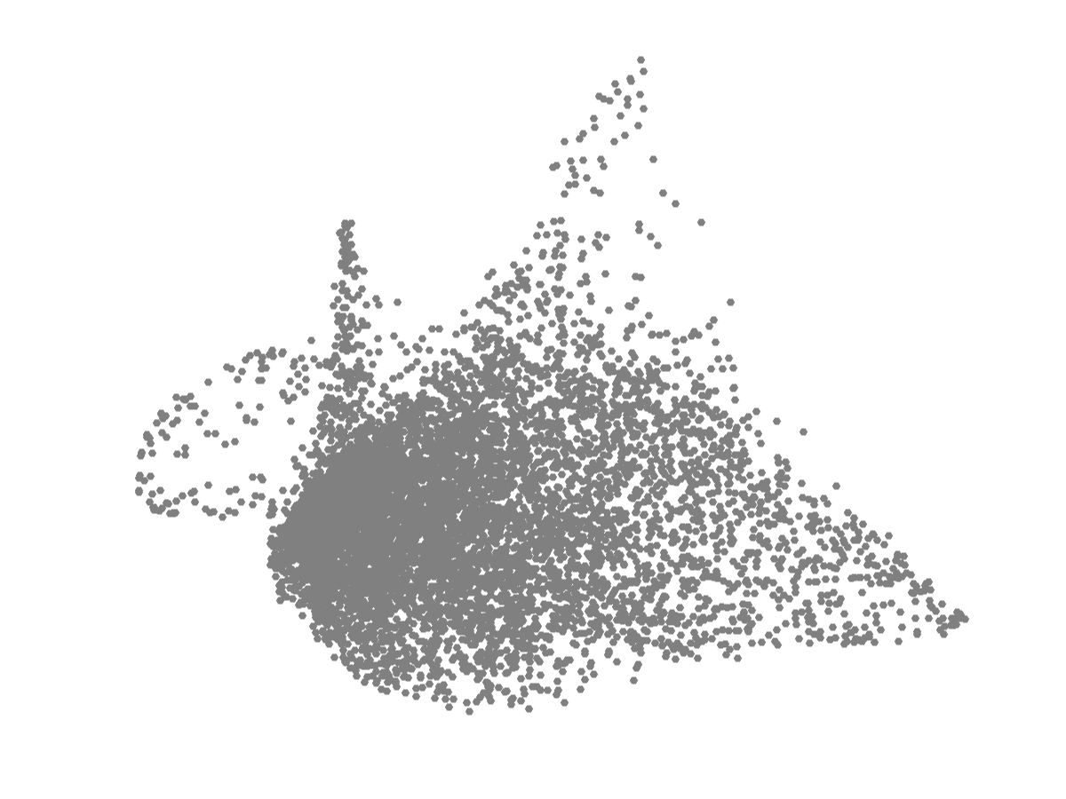
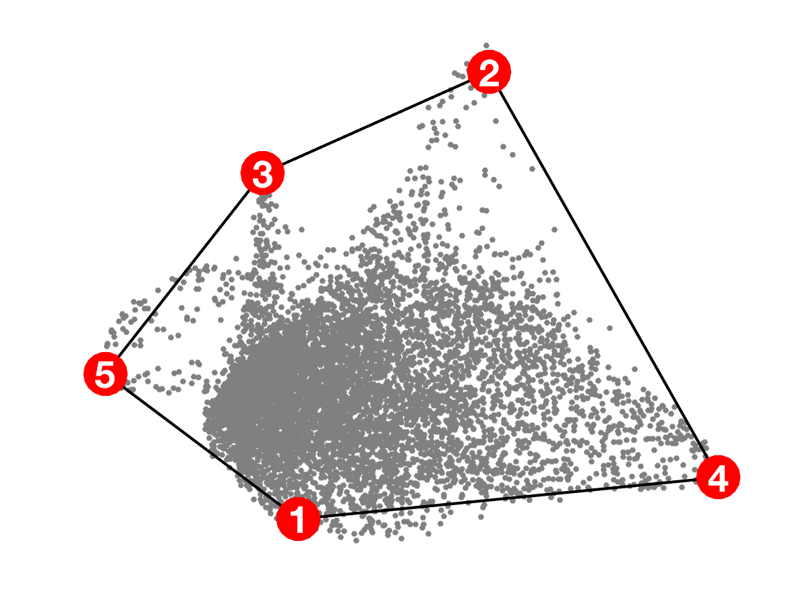
Clustering
Archetypal analysis
(Uri Alon lab: Shoval et al. 2012, Hart et al. 2015)

Slide 35
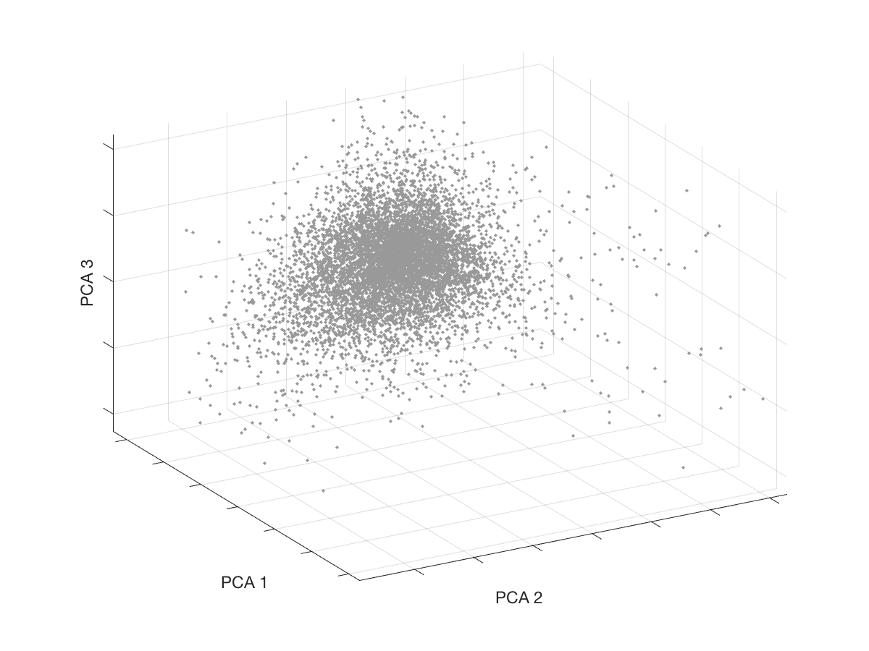
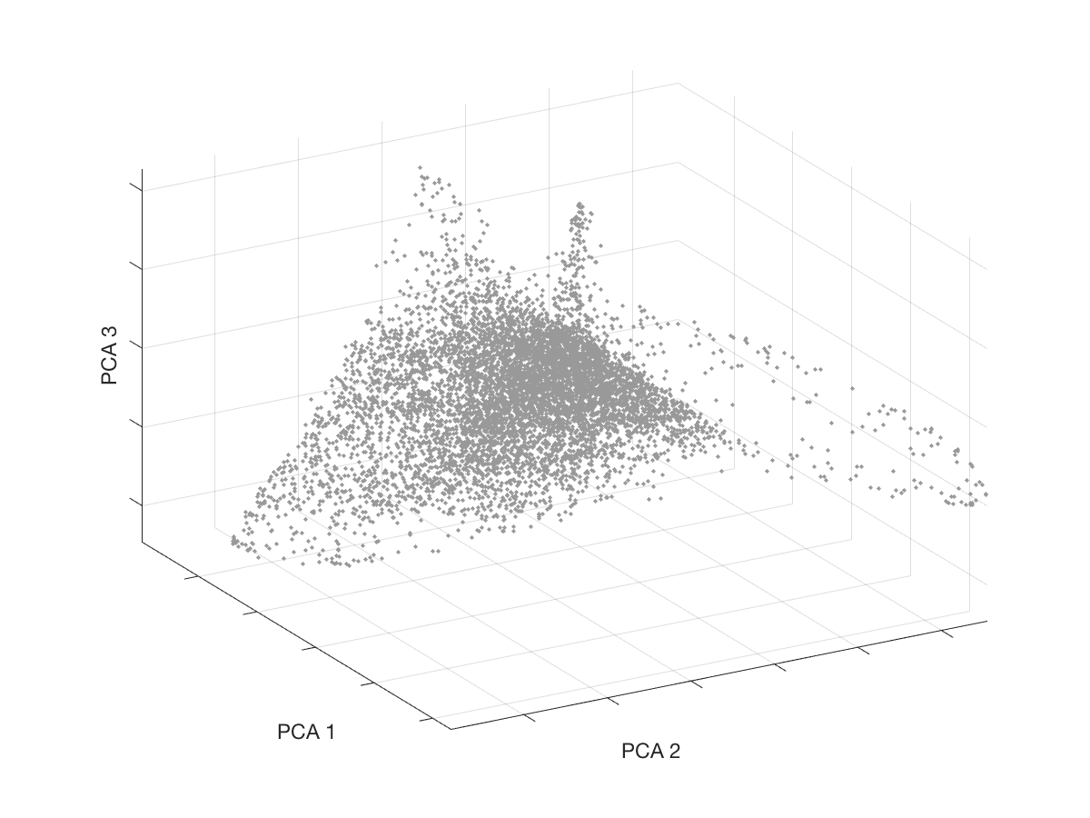
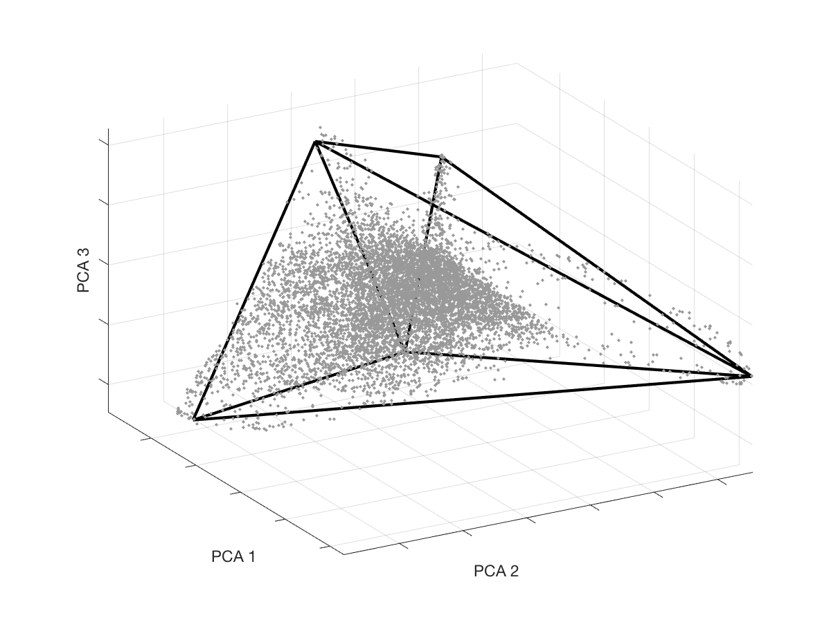
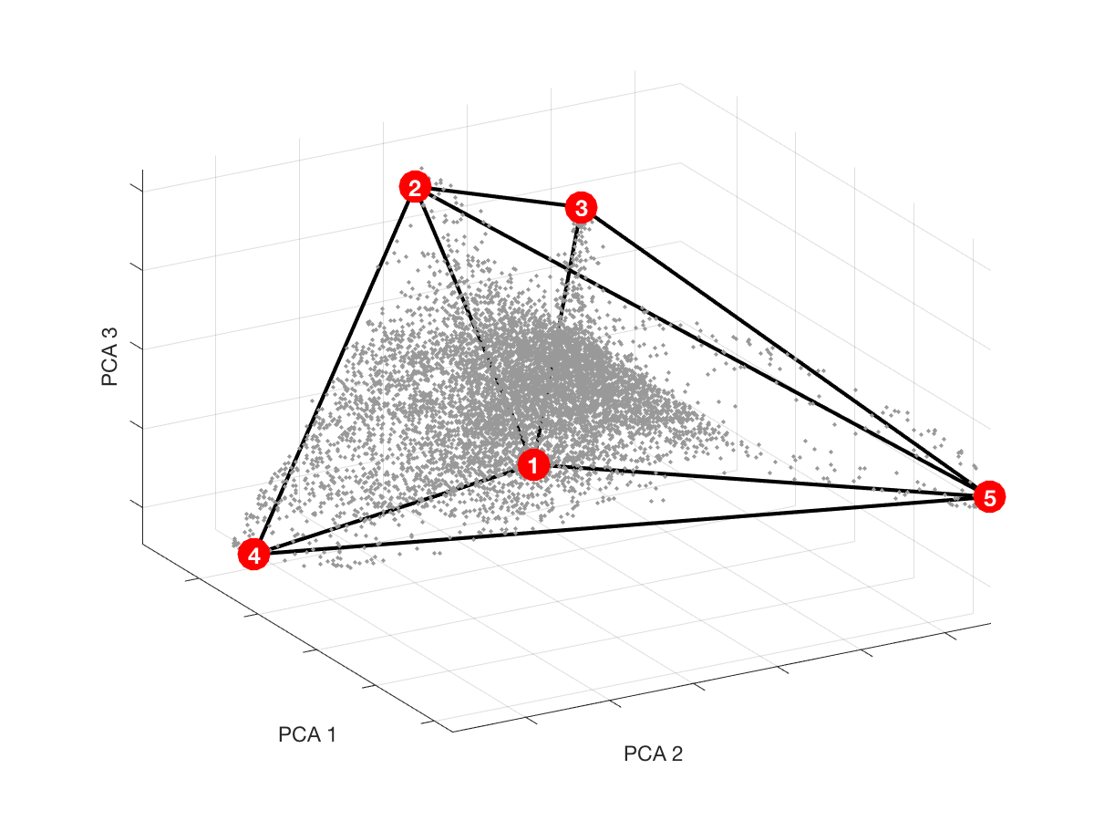
Archetypal Analysis
Data before MAGIC
Data after MAGIC
Fit polytope
Infer archetypes

Slide 36
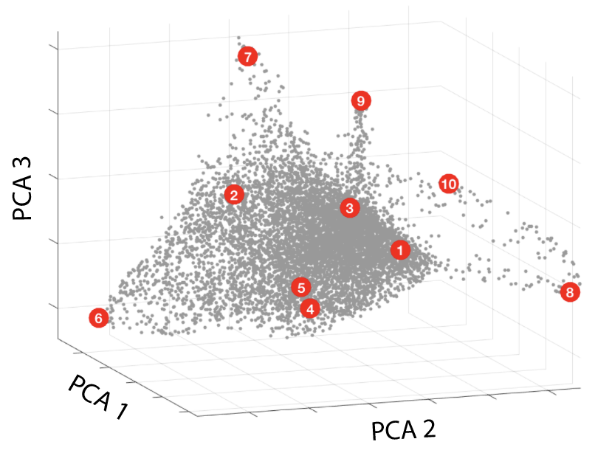
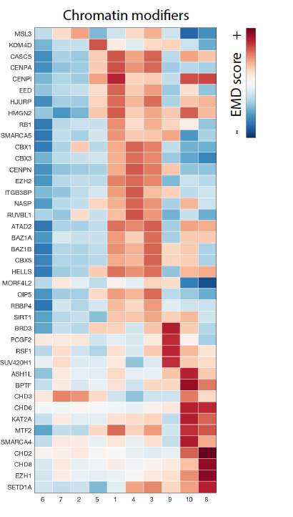
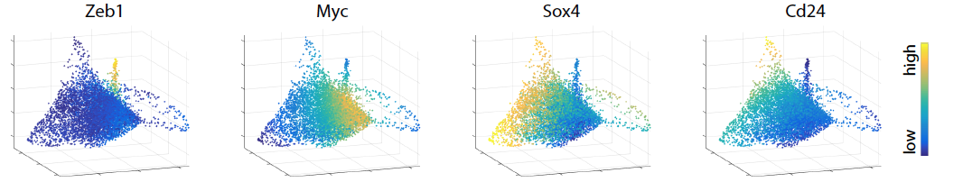
7: Epithelial
9: Mesenchymal
8,10: Apoptotic
6: Epithelial
1-5: Intermediate (stem-like)

Slide 37
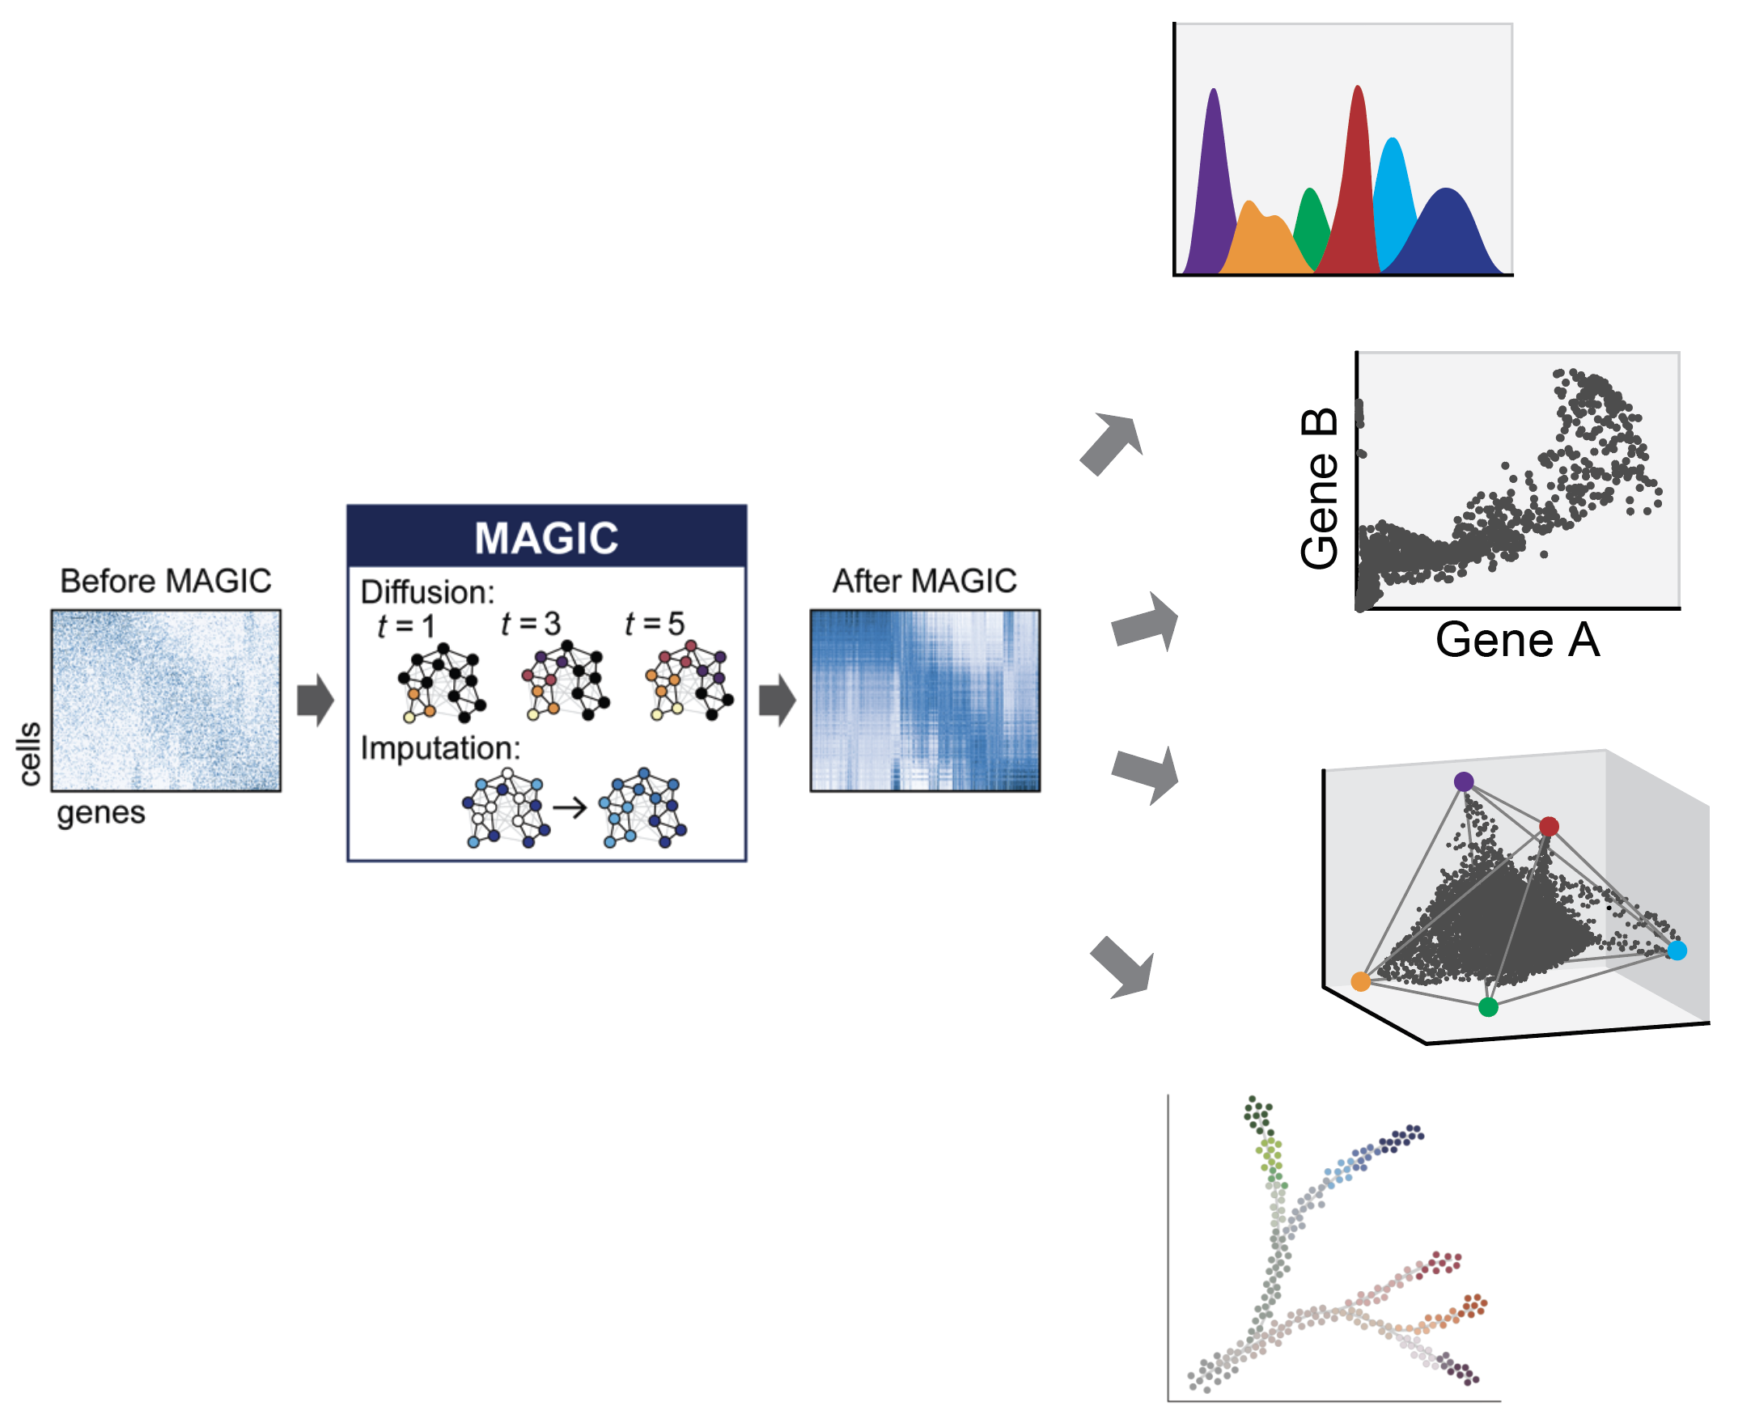
MAGIC enables downstream analyses

Slide 38
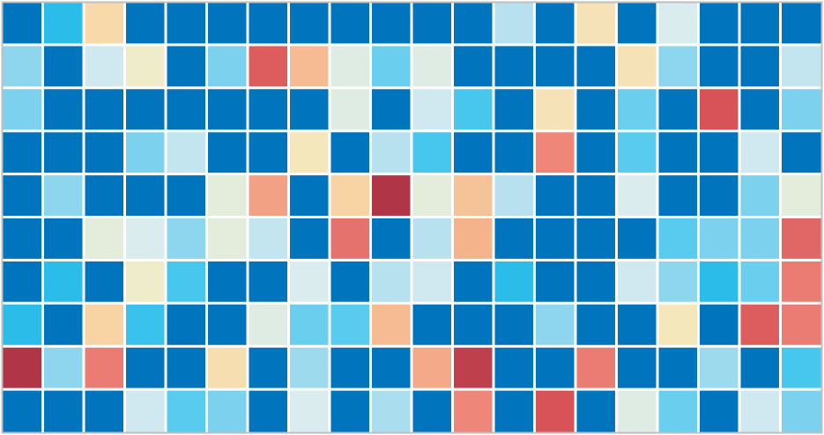
scRNA-seq data
regulatory network
Using “snapshot” scRNA-seq data to predict transcription factor-target interactions involved in the epithelial—mesenchymal transition.
Notes:
One of the major goals of my thesis project: to infer regulatory networks from single-cell RNA-seq data
To put this into biological context…I have been working on

Slide 39

Data after MAGIC
Density estimation
Mutual information
Gene Y
Gene X
low
high
quantifying gene-gene relationships
Notes:
The density estimate is intended to smooth and fill in gaps in the data distribution and therefore requires a finer scale of resolution.
The mutual information can be computed at a coarser scale to find clear and strong relationships, reduces noise.
(use on the order of 20 partitions in both the X and the Y directions) and accumulate the density estimates for each grid point in the partition to obtain the coarser joint density distribution on which to compute entropy

Slide 40
ZEB1
Genes that peak after ZEB1 (putative targets)
Epithelial
Mesenchymal
Increasing VIM (EMT time)
Notes:
Each row in this heatmap is a gene – filtered for genes that have high DREMI with VIM
Genes are grouped based on the DREVI shape, and ordered by

Slide 41
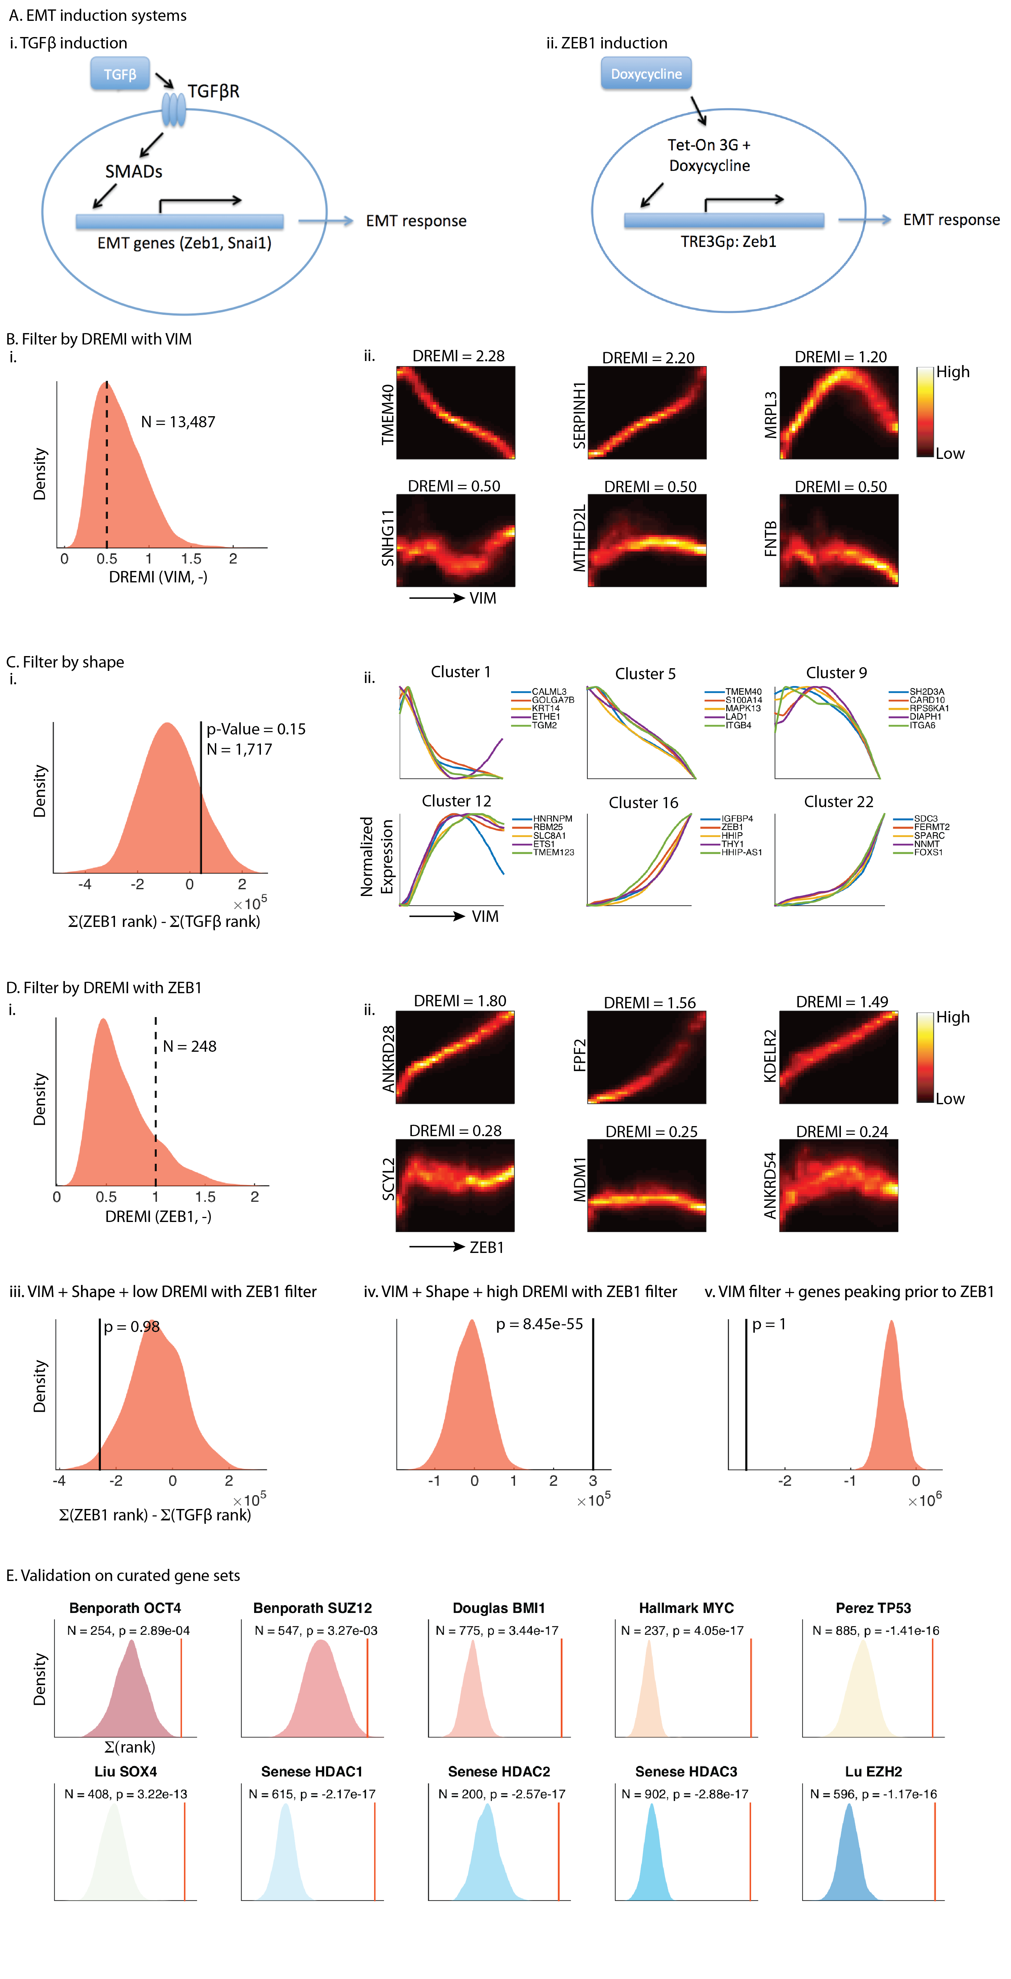
Validating predictions with ZEB1 induction
TGFβ induction of EMT
ZEB1 induction of EMT
TGFβ
Doxycycline
With Weinberg Lab (Whitehead):
Diwakar Pattabiraman, Brian Bierie, Christine Chaffer
Notes:
Tetracyline response element upstream of the ZEB1 promoter – used to induce ZEB1 expression

Slide 42
Validating predictions with ZEB1 induction
Predicted targets
Background/null distribution
Notes:
Large difference corresponds to a large lncrease in total rank in ZEB1 compared to TGFb.

Slide 43
Summary
scRNA-seq data is sparse and noisy
Sparsity obscures biology
Imputation via manifold learning (MAGIC)
Imputed data enables down stream analyses

